Slide 1
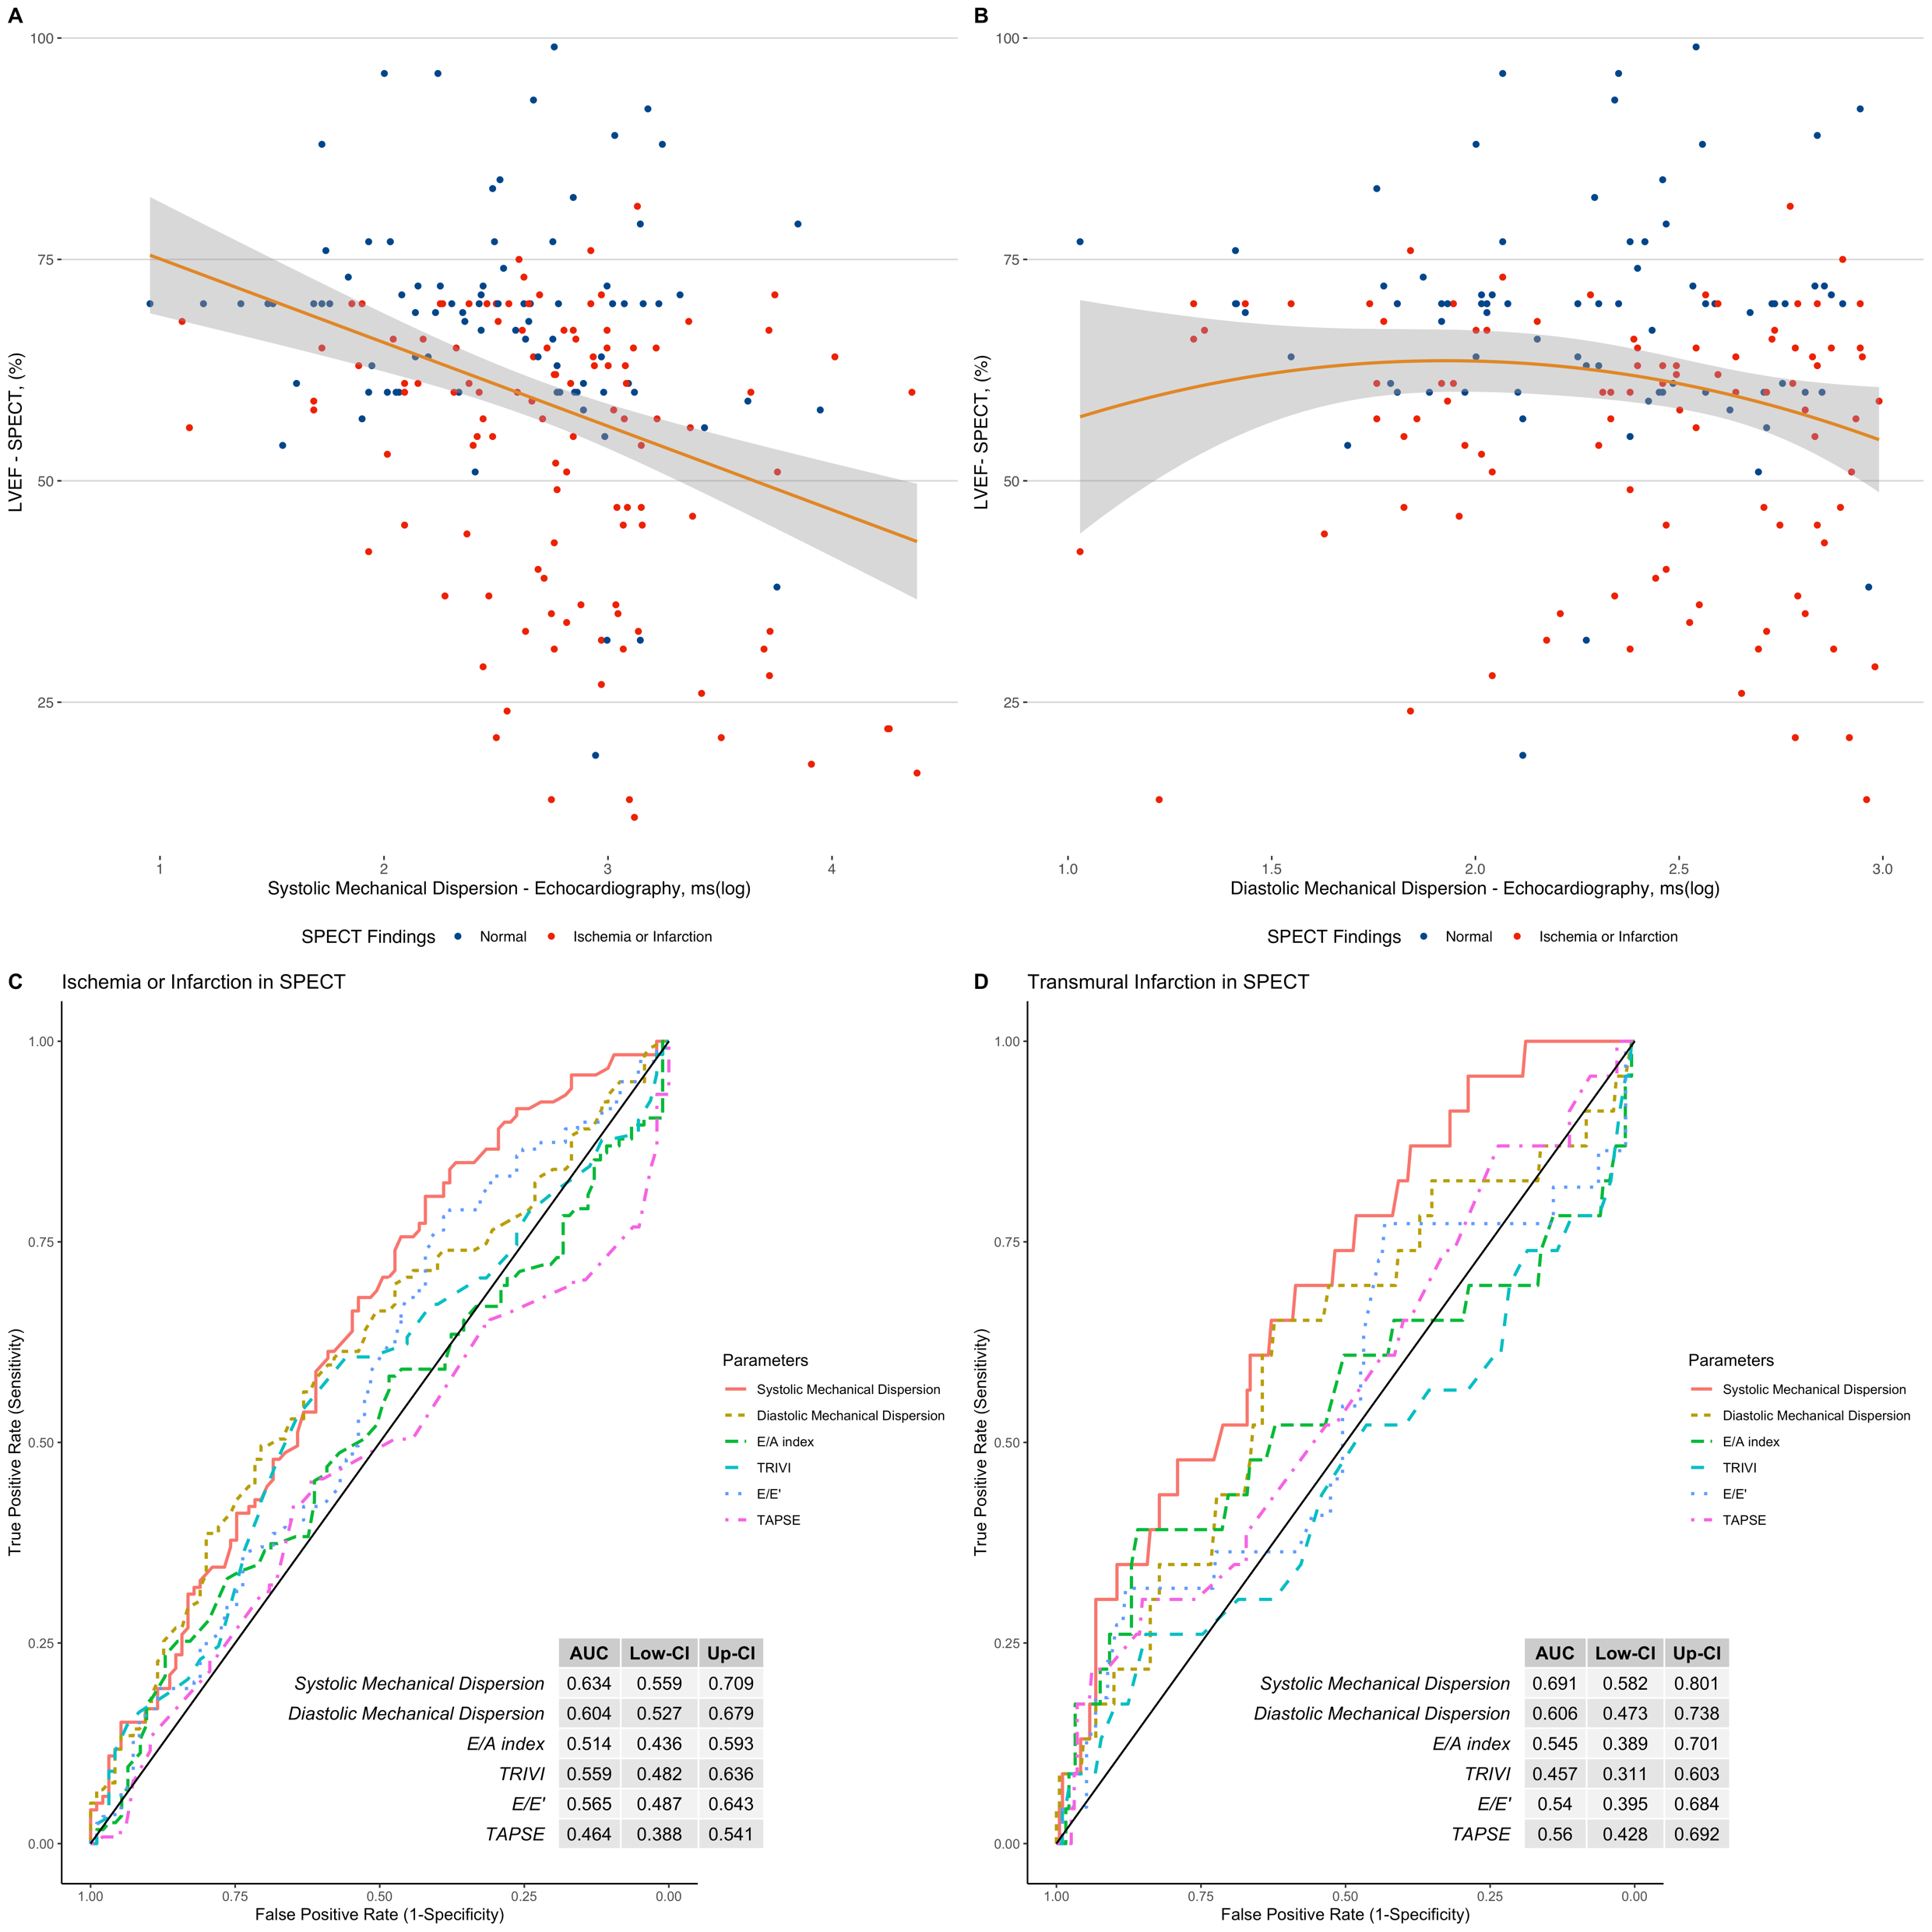


CLINICAL UTILITY OF MECHANICAL ECHOCARDIOGRAPHIC DISPERSION TO ASSESS LEFT VENTRICULAR FUNCTION AND ISCHEMIA OR INFARCTION DETECTED BY GATED 99M-TC SESTAMIBI-SPECT
discussion
3D echocardiography evaluates all segments of the left ventricle (LV) simultaneously, making the volume calculation more accurate and reproducible. For analysis of LV dyssynchrony, LV segment volumes are plotted as a function of time throughout the cardiac cycle. In an asynchronous ventricle, there is dispersion in the synchronization of regional segments that reach a minimum volume later in ventricular systole. This is the first study that has compared the impact of LV asynchrony with the size of the infarct determined by the myocardial perfusion study with gated 99m-Tc Sestamibi SPECT.
Nilda Espinola-Zavaleta¹, Neftali Eduardo Antonio-Villa², Ricardo Alvarez-Santana¹, Erick Alexanderson-Rosas¹.
1.-National Institute of Cardiology Ignacio Chavez, Mexico City, Mexico
2.- MD/PhD (PECEM) Program, Faculty of Medicine, National Autonomous University of Mexico, Mexico City, Mexico
Systolic and diastolic mechanical dispersion assessed by 3D echocardiography
are simple parameters for the evaluation of left ventricular function and ischemia or infarction
Background
Figure 1
Coronary artery disease is the leading cause of morbidity and mortality worldwide. Left ventricular echocardiographic asynchrony could be useful for detection of ischemia or infarction.
AIM
To assess the systolic and diastolic mechanical dispersion (MD) by 3D-ECHO and its correlation with left ventricular ejection fraction (LVEF) and ischemia or infarction by myocardial perfusion study (MPS) gated 99m-Tc Sestamibi-SPECT.
Methods
Cross-sectional study of patients with angina. Systolic and diastolic MD was calculated by the standard deviation of the time to achieve the minimum volume corrected for the R-R interval. Association with LVEF was assessed with correlation and linear regression. ROC curves identified ischemia or infarction and compared with E/A, TRIVI, E/e’ and TAPSE.
RESULTS
Two-hundred twenty-nine patients were studied with median age 61 (IQR: 54-69) years. 53.2% (n=122) had ischemia/infarction.
We observed a negative correlation with systolic (r= -0.343, 95% -0.459 to -0.215; p<0.001) and diastolic (r= -0.184, 95% -0.314 to -0.047; p<0.01) MD and MPS-LVEF, which contributes to 8.9% and 11.8% of variance, respectively.
Both parameters displayed and AUC of 0.634 (95% 0.559-0.709, p<0.001) and 0.604 (95% CI 0.527-0.679, p<0.001) are shown to detect ischemia/infarction.
The systolic MD AUC improved to 0.691 (95% 0.582-0.801, p<0.05) in transmural infarction (Figure 1).
For more information, scan the QR code, go to https://github.com/nefoantonio/ACC_21_ECO_SPECT
email niesza2001@hotmail.com and nefoantonio@hotmail.com
Correlation analysis of systolic (A) and diastolic (B) mechanical dispersion with left ventricular ejection fraction assessed with MPS-SPECT. ROC curve analysis to assess the AUC for different echocardiographic parameters for ischemia or infarction (C) and transmural infarction (D) with MPS-SPECT.
disclosure INFORMATION
CONCLUSION
Presenter* Disclosure: No disclosure to declare
Lead investigator* Disclosure: No disclosure to declare
Systolic and diastolic MD are useful and simple parameters for the assessment of left ventricular function and ischemia or infarction.

